Slide 1
Advanced Techniques with Large Language Models Lecture 5
Northeastern University
College of Engineering
Multidisciplinary Graduate Engineering Department
INFO 6105 – Fall 2024
Instructor: Abdolreza Mosaddegh

Slide 2
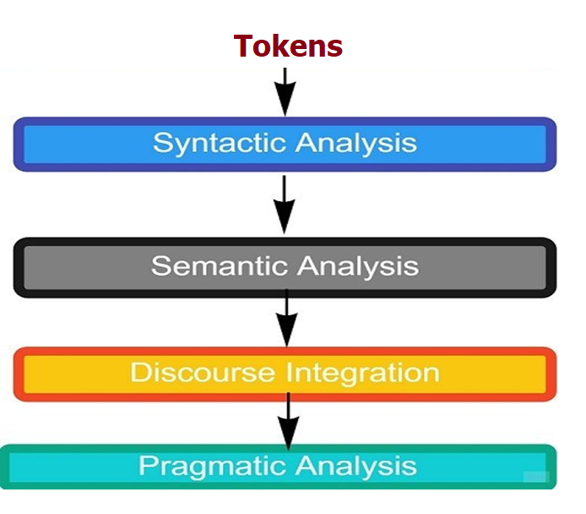
Deep Learning Approach for NLP
After tokenizing, NLP phases includes capturing syntactic dependencies and meaning of the words/tokens in different contexts besides discourse integration and pragmatic analysis.
Tokens can be processed by deep neural networks to realize NLP phases

Slide 3
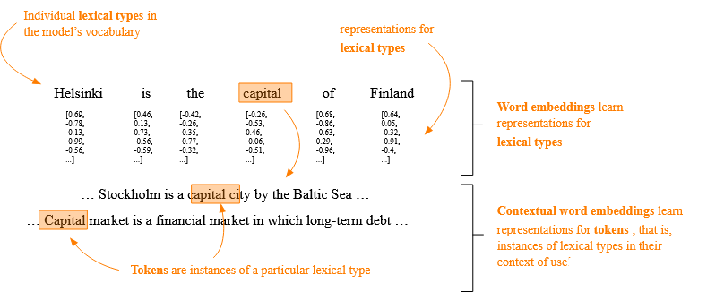
Problem Statement
We need to convert tokens to numbers to process them with neural networks
These numbers should present meanings of the words
Meaning of words can be different in various contexts (e.g., capital)
1,2,3 → We need a mechanism to encode contextual meaning of words with numbers

Slide 4
Describing Meaning of Words using Features
We can use characteristic (features) of words to represent their meaning.
E.g., King: A top rank person (male) in a monarchy political system who is …
We can also use characteristic (features) of a text to represent the meaning or context
E.g., Antimicrobial resistance is growing in recent years
 | Gender | Political Rank | Political System | …
King | M | Top | Monarchy
 | Type | Category | Topic | …
Antimicrobial resistance is growing in recent years | Scientific | Medicine | Antimicrobial Resistance

Slide 5
Words as Vectors
The features of a word can be encoded by numbers
These numbers can be represented by a vector as an ordered list of numbers
Features of a word are dimensions of the vector
 | Encoding
Gender | F=1, M= 2
Political Rank | Between 1 to 10
Political System | Monarchy=1, Republic =2
 | Gender | Political Rank | Political System | …
King | M | Top | Monarchy
 | 2 | 10 | 1
Gender
Vector with the same dimensions and encoded values:
[2, 10, 1]
Political Rank
Political System

Slide 6
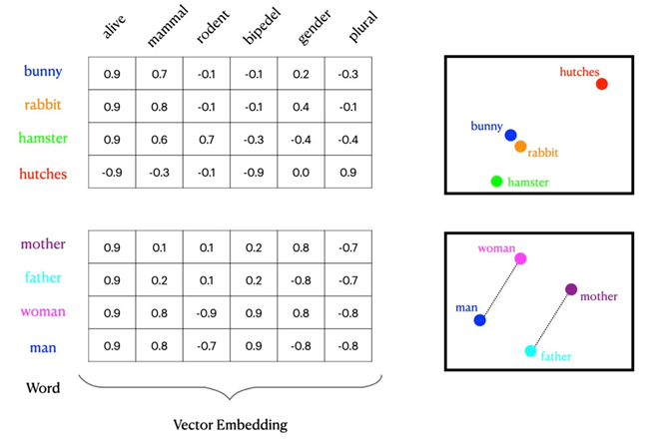
Why Vectors?
Vectors can represent distance between meanings
Vectors can be transformed, make it possible to define a general meaning for a word and then transform it based on context
Vectors represent relationships and similarities between concepts
Vectors can be scaled to represent different types of data

Slide 7
Representing Distance
Vector can represent distance between meanings:
 | Gender | Political Rank | Political System | …
King | M | Top | Monarchy
Queen | F | Top | Monarchy
Prince | M | High | Monarchy
Princess | F | High | Monarchy
Gender
E(King)= [2, 10, 1]
Prince
King
2
1
E(Queen)= [1, 10, 1]
E(Prince)= [2, 9, 1]
Queen
Princess
E(Princess)= [1, 9, 1]
9 10
Political Rank
E(King) - E(Queen)= E(Prince)- E(Princess) = [1,0,0]
E(King) - E(Prince) = E(Queen) - E(Princess) = [0,1,0]

Slide 8
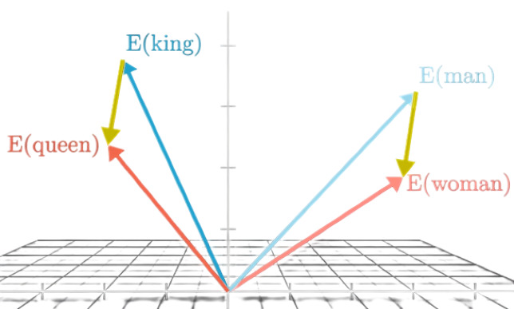
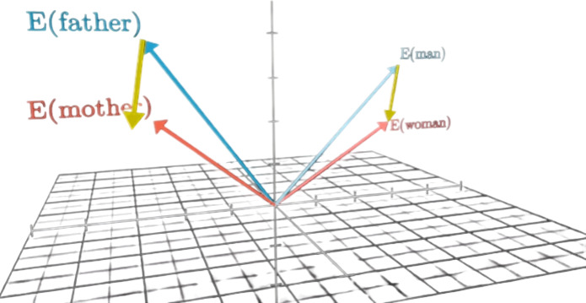
Transformation
Vectors can be transformed.
It is possible to transform the vector of a word

Slide 9
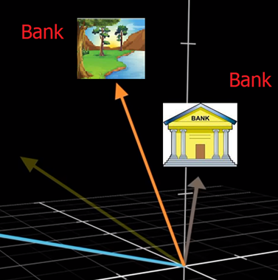
Transforming Vectors - Usage
Transform vector representation of a word in different contexts (e.g., bank as financial institution vs bank as land alongside a river)
Transform vector representation of a word to a different languages in translation tasks (e.g., Hello to Bonjour)
Add new characteristic to an embedding
Plural_Transform = E(cats)-E(cat)
E(student) + Plural_Transform = E(students)

Slide 10
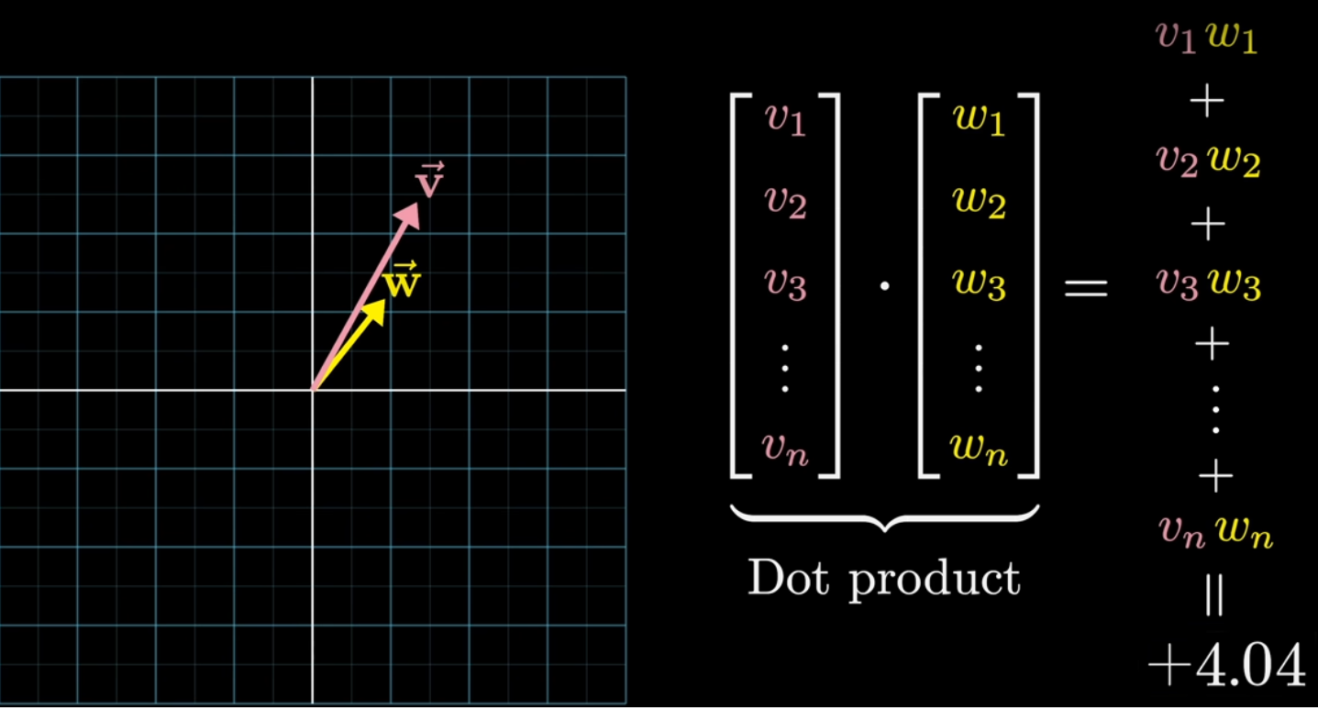
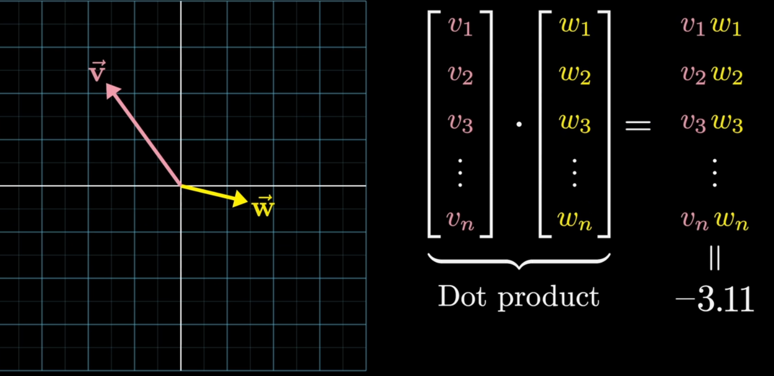
Alignment
The dot product of vectors provides a measure of their alignment and magnitude:
If two vectors are in the same direction, their dot product is positive and maximized.
If two vectors are in opposite directions , their dot product is negative and minimized.
Cosine Similarity can also be used to identify similarity of vectors (-1 to 1)
similarity of word vectors indicates similarity of meaning (or some aspects) of words

Slide 11
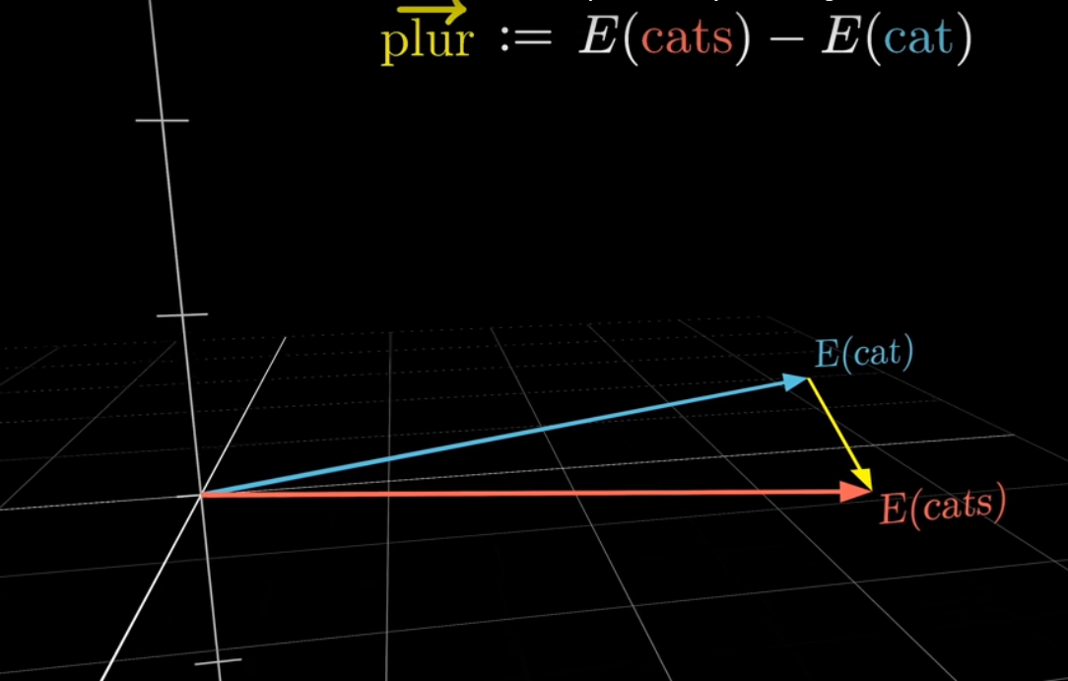
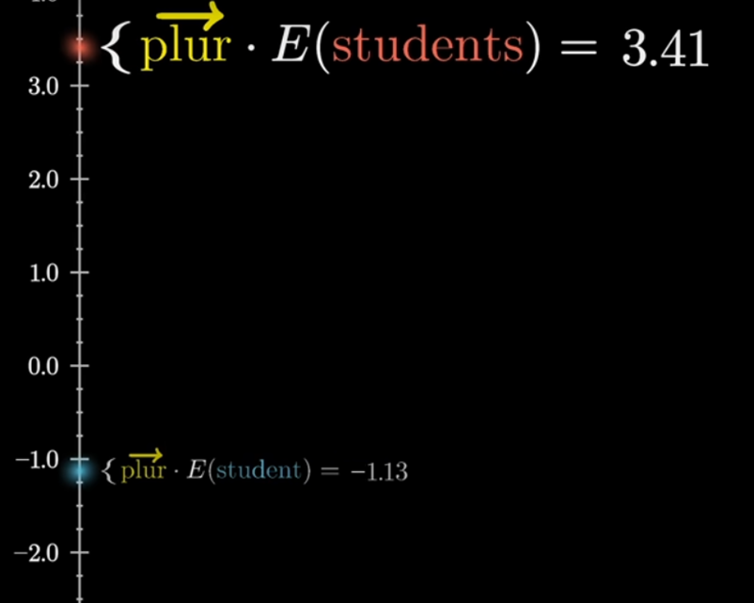
Alignment - Example
The plural vector is more aligned with plural values rather than singular ones. Therefore, the result of dot product operation / Cosine is bigger:
Plural_Vector . E(students) > Plural_Vector . E(student)
Cosine (Plural_Vector, E(students)) > Cosine(Plural_Vector, E(student))

Slide 12
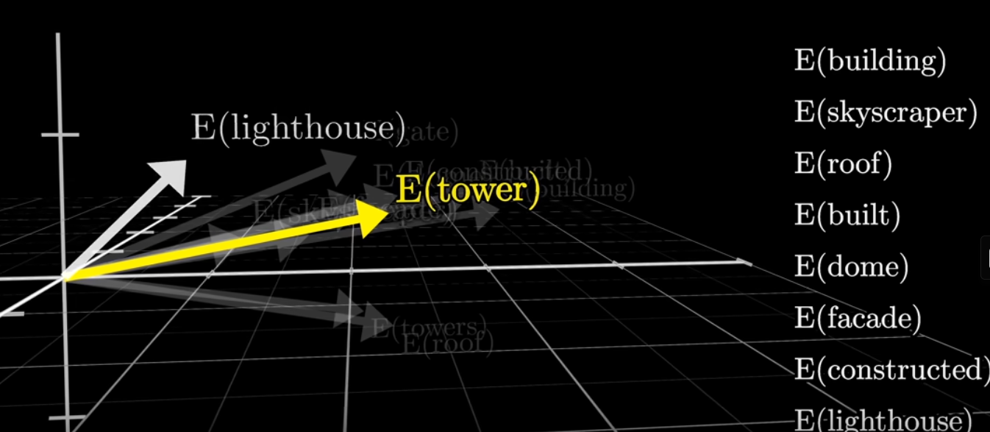
Vectors Capture Relationships
Vectors can capture the relationships between different pieces of data.
Word that have similar meanings are represented by vectors that are close to each other in the vector space.
This spatial relationship encodes semantic meaning, which is useful for tasks like natural language processing (NLP).

Slide 13
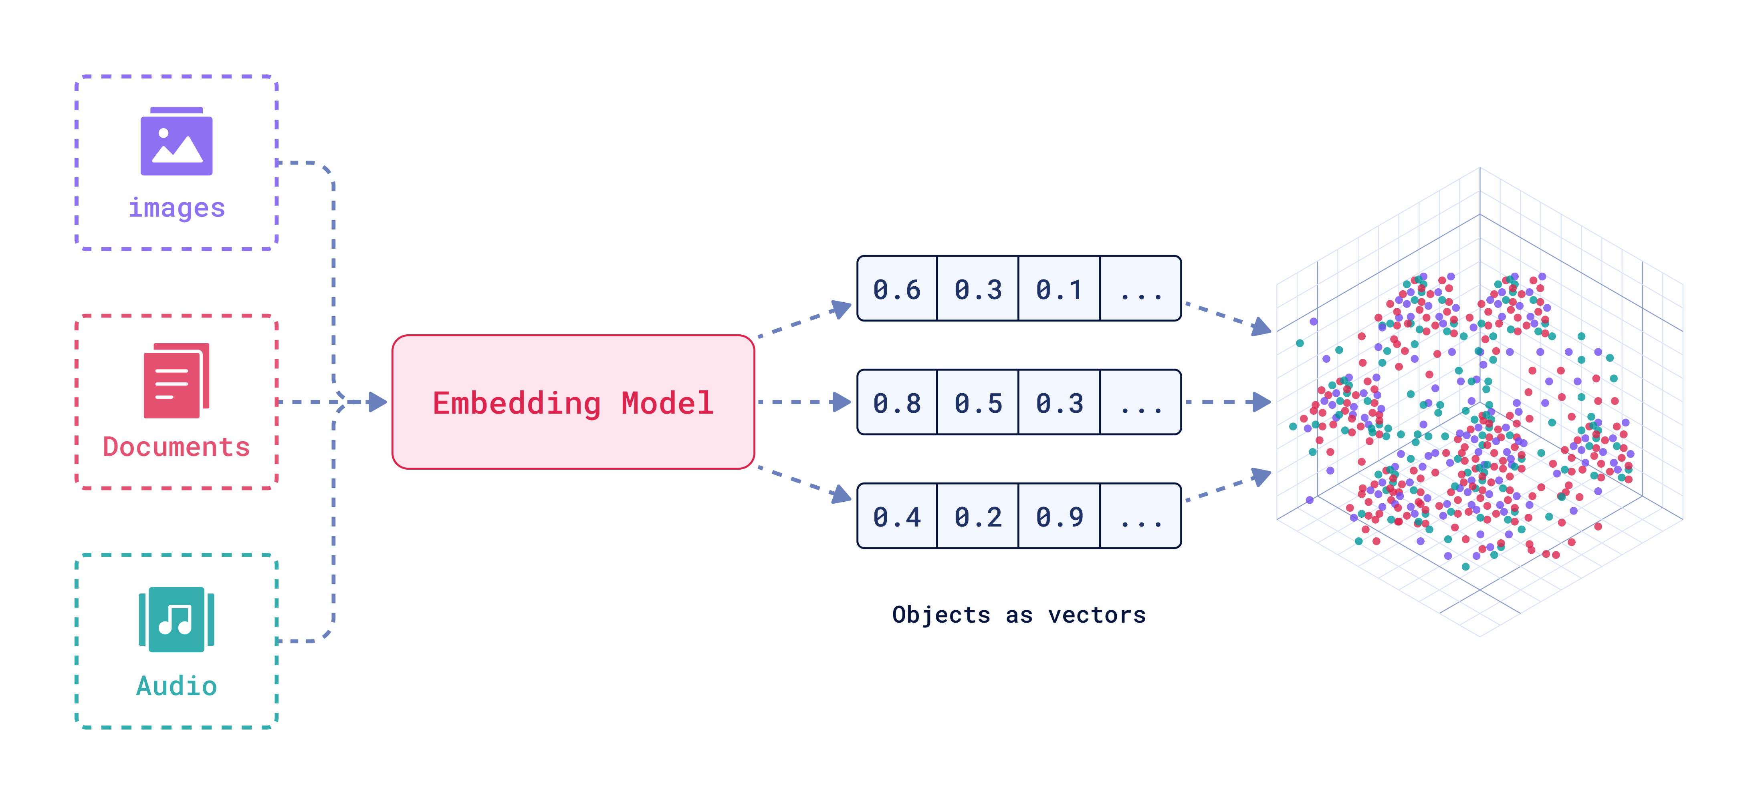
Multi-model Neural Networks
Vectors can represent different types of data, whether it's text, images, or audio.
Neural networks, particularly deep learning models, are designed to work with vectorized data.
The input, weights, and outputs of neural networks are all vectors, making vectors a natural choice for inputs that feed into these models.
qdrant

Slide 14
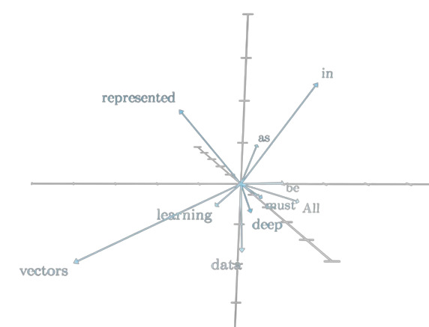
High Dimensional Vectors (Embeddings)
Embedding refer to the vector representation of word/ text.
These vectors capture the semantic meaning of the word/text.
Since there are many attributes for each word / context, there are many dimensions for embeddings which represent words
The vectors are usually of fixed dimensions, like 300 or 768, depending on the model (12288 in GPT3).
Higher-dimensional embeddings can capture more nuanced meanings but also require more computational resources.
Embeddings are foundational to how LLMs process and generate human-like text.
We need some methods to create such embeddings(vectors) from tokens

Slide 15
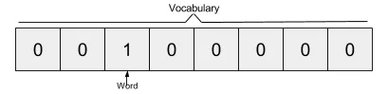
Embedding using One-hot Encoding
One way to create embedding is to create a vocabulary of all the words in a text
Each word is a vector of the same dimensions of the vocabulary.
Each dimension can be thought as a word in the vocabulary.
Resulting vectors contain a single 1 besides zeros and represent the corresponding words in the vocabulary.
This encoding technique is called one-hot encoding.
Example:
Suppose we have a vocabulary made from the words “the quick brown fox jumps over the lazy dog” → [“the”, “quick”, “brown”, “fox”, “jumps”, “over”, “lazy”, “dog”]
the word “the” is represented by this vector: [ 1, 0, 0, 0, 0, 0 ,0 ,0],
the word “quick” is represented by this vector: [ 0, 1, 0, 0, 0, 0 ,0 ,0],
the word “brown” is represented by this vector: [ 0, 0, 1, 0, 0, 0 ,0 ,0],
…

Slide 16
One-hot Encoding - Problems
Distance between words using one-hot encodings always the same
Vector embeddings can not capture semantic
It doesn’t encode context knowledge
dog
cat
person
1
2
3
$$[1 0 0 0 0 0 0 0 0 0 ]$$
$$[0 1 0 0 0 0 0 0 0 0 ]$$
$$[0 0 1 0 0 0 0 0 0 0 ]$$
The vectors will be sparse (most are 0’s) and long (vocabulary size)
What we see

Slide 17
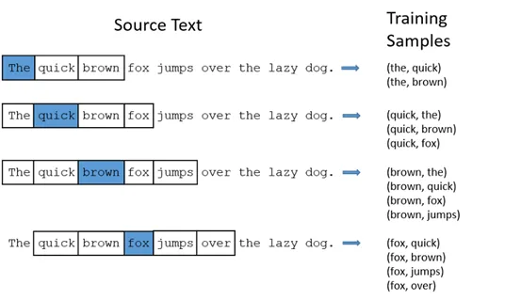
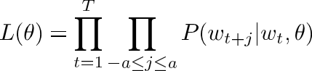
Word2vec
Word2vec is a technique for obtaining vector representations of words.
These vectors capture information about the meaning of the word based on the surrounding words.
The word2vec algorithm estimates these representations by likelihood
To limit the number of words in each context, a parameter called “window size” is used.
There are two main methods to realize Word2Vec: CBOW, Skip-gram
window size of two

Slide 18
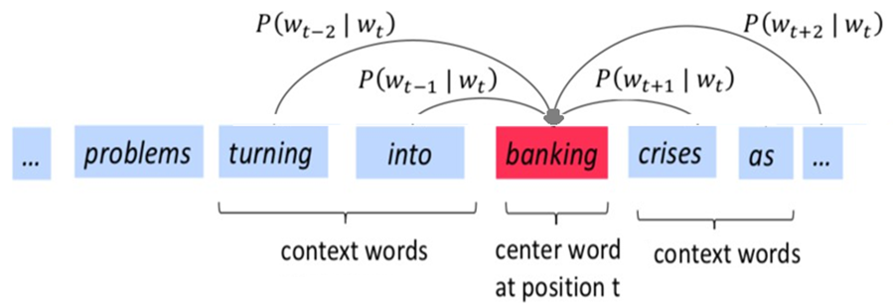
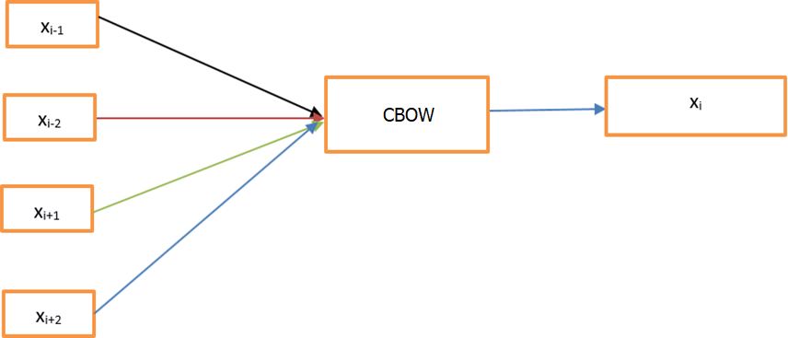
Continuous Bag of Words
The primary goal of the CBOW model is to predict a target word using its surrounding context words.
A prediction model (Neural Network) is trained to predict target word by surrounding words
The context is treated as a "bag of words“, meaning the order of the words doesn't matter.

Slide 19
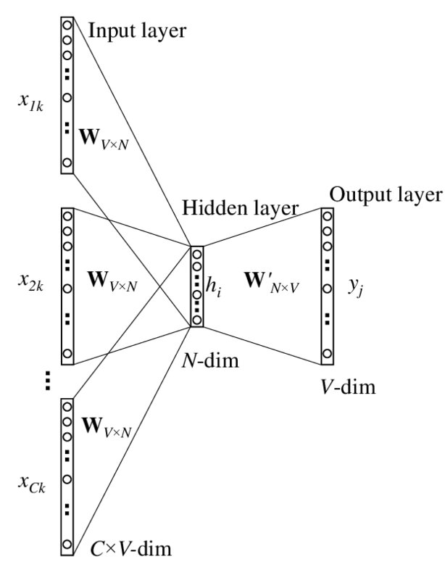
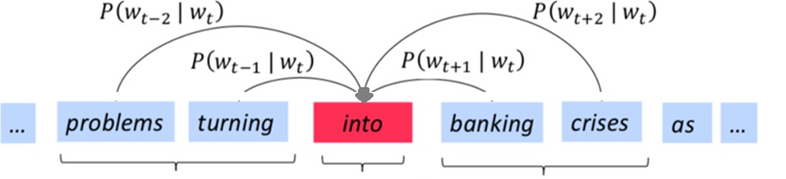
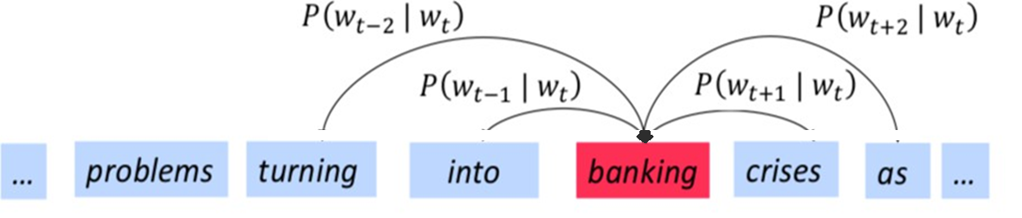
Continuous Bag of Words - Training
The model takes a target word from a corpus and uses it to predict the words that appear within a certain window around it (context window)
The model consists of a single hidden layer neural network
The input to the model is the surrounding words and the output is the predicted target word.
For each occurrence of a word in a text, backpropagation happens once to update weights slightly
The model is trained on a large corpus to learn meaning of the word in different contexts
After training, embeddings are the weights that connect the input layer to the hidden layer

Slide 20
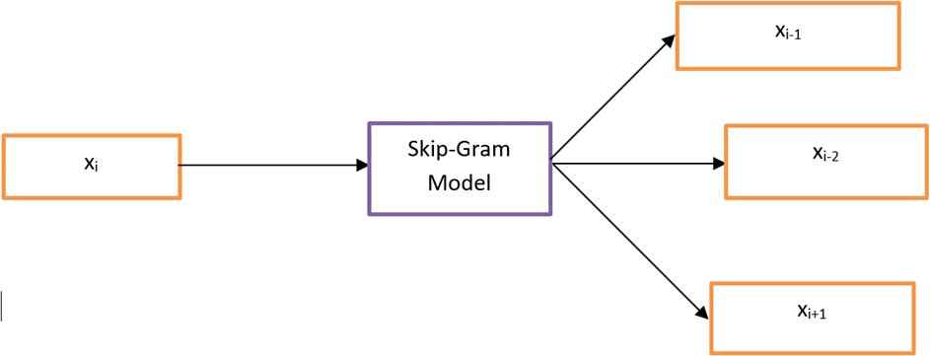
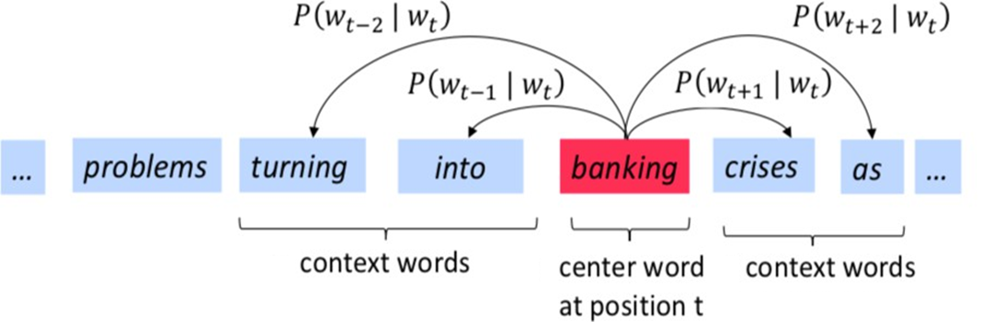
Skip-gram
Using contextual meaning of a word, predicts possible surrounding words
A Neural Network is trained to predict surrounding words by target word

Slide 21
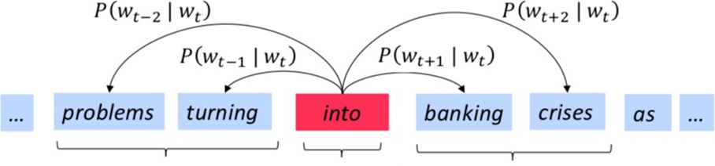
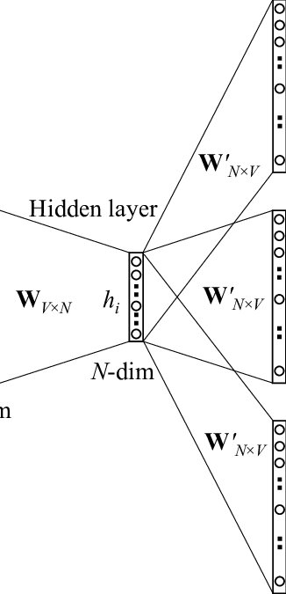
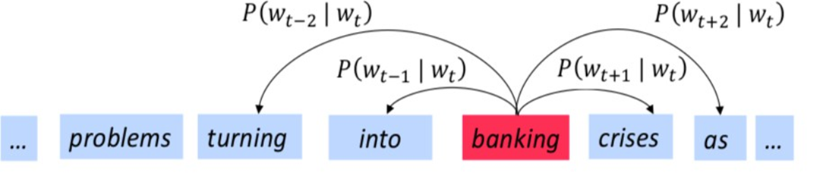
Skip-gram Training
The model takes a target word from a corpus and uses it to predict the words that appear within a certain window around it (context window)
The model consists of a single hidden layer neural network.
The input layer corresponds to the target word, and the output layer corresponds to surrounding words
For each occurrence of a word in a text, backpropagation happens once to update weights slightly
The model is trained on a large corpus to learn meaning of the word in different contexts
After training, embeddings are the weights that connect the input layer to the hidden layer

Slide 22
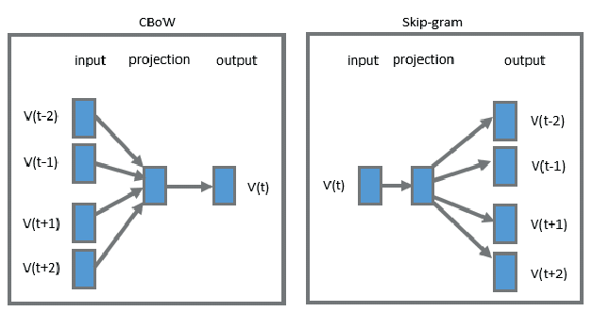
CBOW vs Skip-gram
CBOW:
Generally, more efficient and faster to train. This is because it predicts one word (the target) from a set of context words, reducing the number of predictions per training instance.
Tends to perform better with frequent words. Produces smoother word embeddings because it uses several context words to predict target.
Skip-gram:
Slower to train because it predicts multiple context words for each target word, increasing the number of predictions required.
Performs better with rare words. Captures fine-grained semantics because it focuses on each word individually.

Slide 23
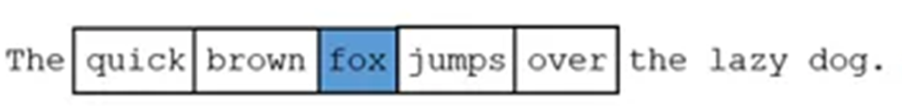
Hyper-parameters
A smaller window size (less than 5) focuses on capturing local context (e.g., syntax and grammatical structures)
Larger window sizes (more than 10) capture a more extensive context. However, they may also introduce noise.
Smaller vector (Less than 100) sizes are less computationally intensive, but they might not capture rich semantic
Larger vector sizes (more than 300) can capture more features, but computationally expensive

Slide 24
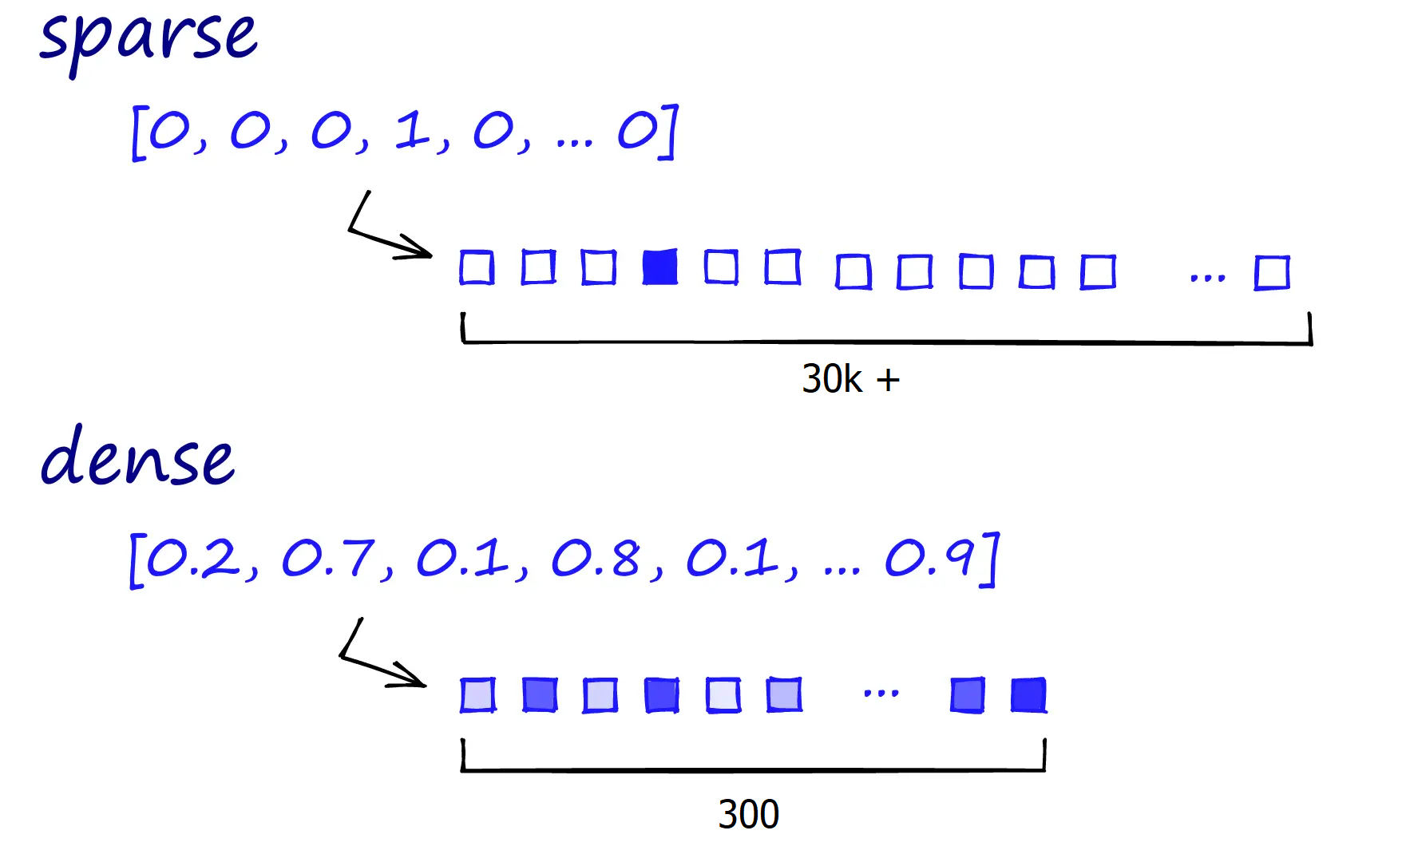
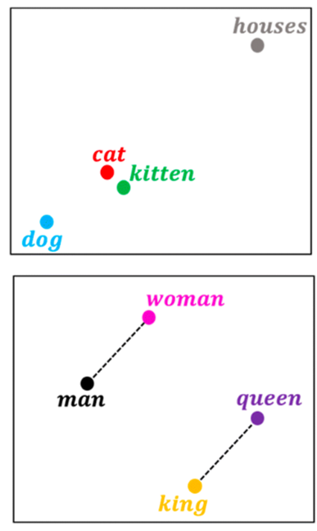
Word2Vec Advantages
Dense Vector:
Represents each word as a dense vector in a continuous vector space (e.g., 100 or 300) encode more information with less size comparing sparse vectors.
Semantic Similarity:
Words with similar meanings are mapped to nearby points in the vector space (e.g., cat and kitten)
Linear Relationships:
Captures linear relationships between words ( e,g., difference between "king" and "queen" is similar to the difference between "man" and "woman.“)

Slide 25


Word2Vec Limitation
In Word2Vec word embeddings are applied in a context free manner
open a bank account on the river bank
[0.3, 0.2, -0.8, …]
One vector for each word
To Include contextual representation, we need different embeddings in different context:
[0.9, -0.2, 1.6, …]
[-1.9, -0.4, 0.1, …]
open a bank account
on the river bank

Slide 26
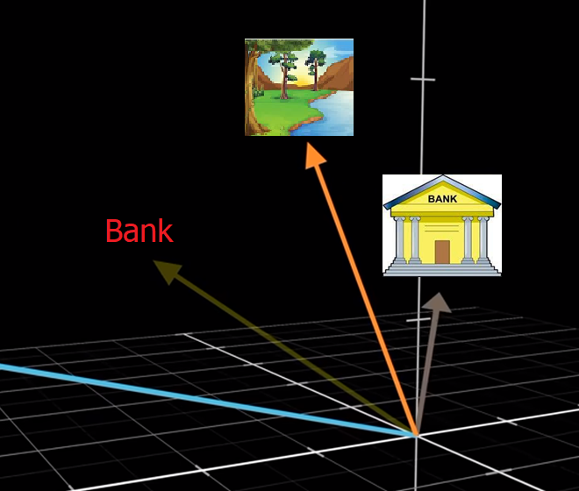
Contextual Representations of Words - Idea
Meaning of a word is different in various context
A general embedding is the average of embeddings of a word in different contexts
In different context we need to transform this general embedding
We need a mechanism to change embeddings based on context (Self Attention)

Slide 27
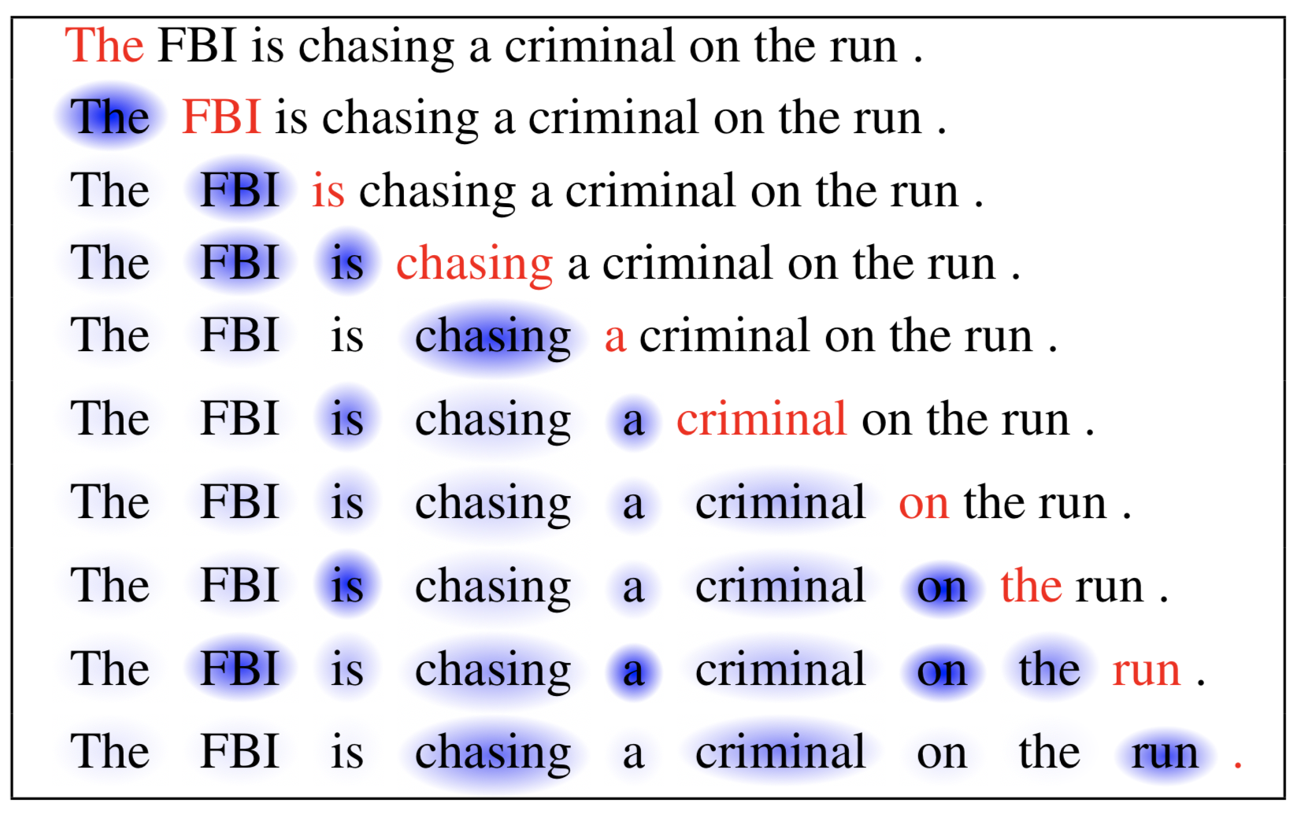
Self Attention - Idea
Extract different aspects of a target word
Determine the relevance of other words in the text regarding that aspect
Transfer the word embedding by applying effect of relevant words
Repeat the process for all the words in the text
open a bank account
on the river bank
open a bank account

Slide 28
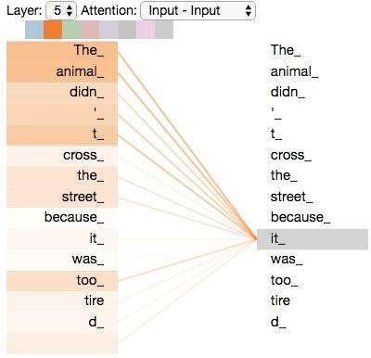
Self-Attention
Each words attends to every other words to add effect based on relevance
Despite the attention mechanism in RNNs this attention is not between encoder and decoder (just encoder side), so it is called self-attention
To extract different aspect of words’ meaning a set of queries is used
Keys presents relevance of words to queries
Values transform the embedding of target word by embedding of relevant words
jalammar

Slide 29



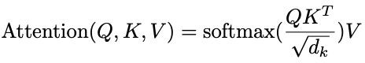
Self-Attention Components
Query and Keyes are like Question and Answers about different aspects of words
Relevance: how likely each query matches key
Value: Transfer of the target word’s embedding by other words
Softmax: Normalizing results
queries keys
values
outputs
.
=
softmax
Inputs
Wq
A
Female
Monarch
Who
…
Wk
Wv

Slide 30
Attention - Intuitive example
Text: A female monarch who was a princess formerly …
What is the impact of other words on embedding of monarch in this context?
 | Gender | Political Rank | Political System | …
King | M | Top | Monarchy
Queen | F | Top | Monarchy
Monarch | - | Top | Monarchy
Princess | F | High | Monarchy
Female | F | - | -
Gender
E(King)= [2, 10, 1]
Queen
E(Queen)= [1, 10, 1]
E(Monarch)= [0, 10, 1]
King
E(Princess)= [1, 9, 1]
Monarch
E(Female)= [1, 0, 0]
Political Rank
Self Attention:
Query 1: What Gender? Key1: Gender Related Information
Query 2: … Key2: ….

Slide 31
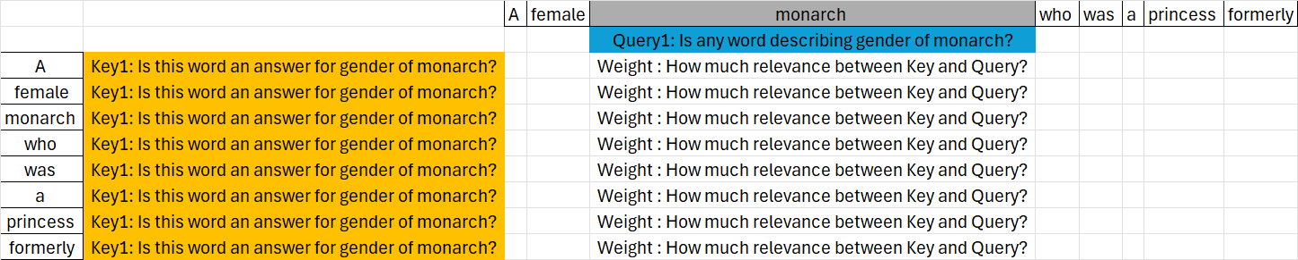
Attention - Intuitive example
In this example, effect of other words on monarch regarding one query and one key is considered.
The process is repeated for other words in self-attention mechanism.
In this intuitive example we simplified the Key and Query concepts

Slide 32
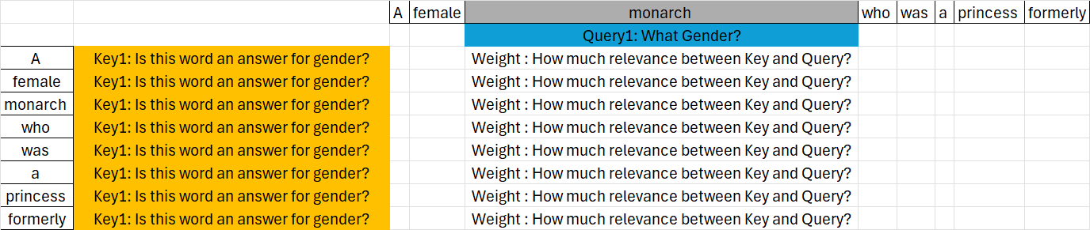
Attention - Intuitive example
Wk should extracts the gender attributes of the words describing monarch, if there is any
It means dot product by the Wk vector should change embedding in a way that the result vector be aligned with gender dimension and strip other embedding of the words not relevant to key
Gender, …
[0, 0, 0,..]
[1, 0, 0,..]
[0, 10, 1,..]
[0, 0, 0,..]
[0, 0, 0,..]
[0, 0, 0,..]
[1, 9, 1,..]
[0, 0, 0,..]
Wk
1 | 0 | 0
0 | 0 | 0
0 | 0 | 0
[1, 9, 1] * = [1, 0, 0]
[1, 0, 0] * = [1, 0, 0]
1 | 0 | 0
0 | 0 | 0
0 | 0 | 0
[0, 10, 1] * = [0, 0, 0]
1 | 0 | 0
0 | 0 | 0
0 | 0 | 0

Slide 33
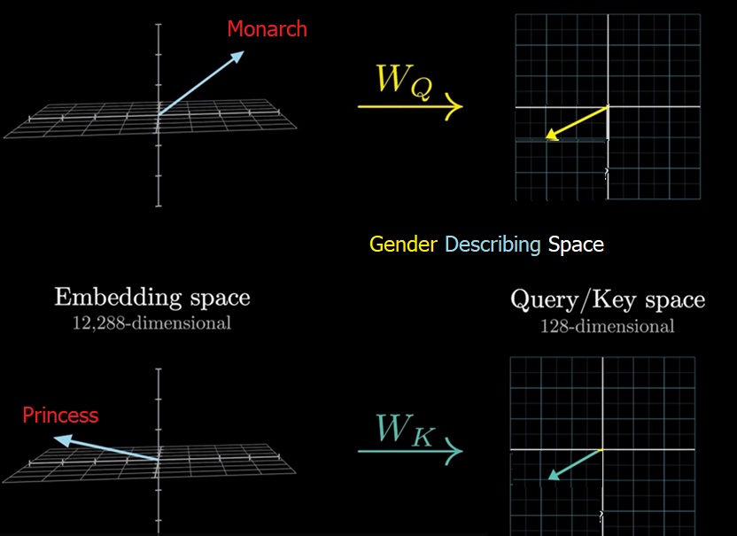
Self-Attention - Relevance
Wq and Wk vectors should act in a way that Query and Key will be in a same direction just if a key is relevant to query, so the dot product of them creates a big value showing the relevance of the words. And for cases which are not relevant dot product will be small
Wq and Wk should just extract those dimensions which are relevant (e.g., gender) which are smaller set of dimensions
Q.K will be high if a word is relevant to query

Slide 34
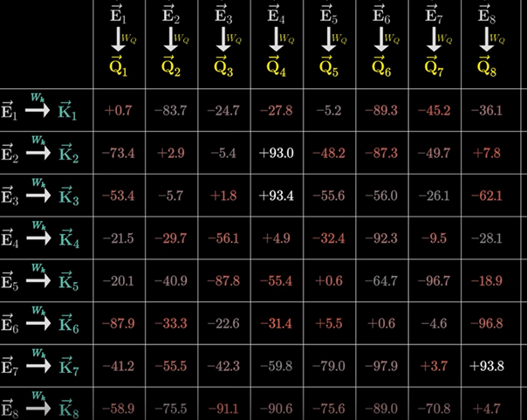
Self-Attention - Normalizing
Bigger dot product showing more relevance
the values are divided by the square root of the dimension of the key vectors.
Then normalized using Softmax
If the dimension of the key vectors is large, the dot product can result in very large values. These large values can cause the softmax function to produce very sharp distributions. A sharp distribution means that the model might become overly confident in certain positions, effectively ignoring other relevant parts of the sequence.

Slide 35
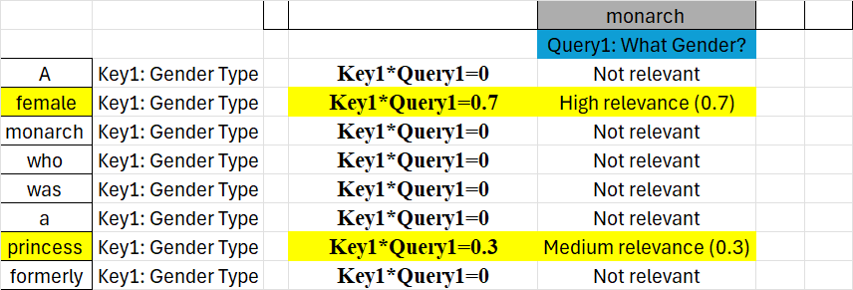
Attention - Intuitive example
The relevance is based on alignment of key and query
The results is normalized

Slide 36
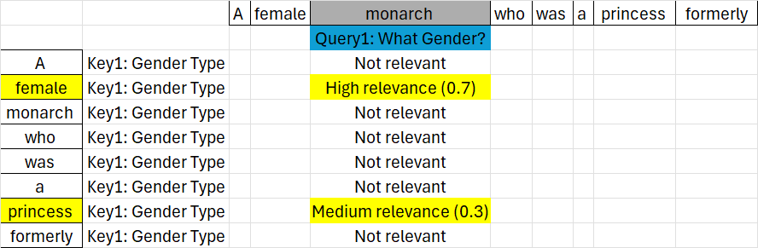
Attention - Intuitive example
We need also to add values that transform the vector of embeddings based on related dimensions (e.g., gender),therefore, the value vector is another parameter of the model
[0, 0, 0,..]
[1, 0, 0,..]
[0, 10, 1,..]
[0, 0, 0,..]
[0, 0, 0,..]
[0, 0, 0,..]
[1, 9, 1,..]
[0, 0, 0,..]
Based on relevance and value each word attend on embedding of the target word
Wv
1 | 0 | 0
0 | 0 | 0
0 | 0 | 0
[1, 9, 1] * = [1, 0, 0] → [1, 0, 0] * 0.7 = [0.7, 0, 0]
[1, 0, 0] * = [1, 0, 0] → [1, 0, 0] * 0.3 = [0.3, 0, 0]
1 | 0 | 0
0 | 0 | 0
0 | 0 | 0

Slide 37
Attention - Intuitive example
Embedding of target word will be transformed using total weighted values of other embeddings which reflect the context
 | Gender | Political Rank | Political System | …
King | M | Top | Monarchy
Queen | F | Top | Monarchy
Monarch | - | Top | Monarchy
Princess | F | High | Monarchy
Female | F | - | -
Gender
E(King)= [2, 10, 1]
Queen
E(Queen)= [1, 10, 1]
E(Monarch)= [0, 10, 1]
King
E(Princess)= [1, 9, 1]
Monarch
E(Female)= [1, 0, 0]
Political Rank
E(Monarch) + [0.7, 0, 0] + [0.3, 0, 0] = [0, 10, 1] + [1,0,0] = [1,10,1] = E(Queen)
Monarch in this context is equivalent to the concept of Queen

Slide 38
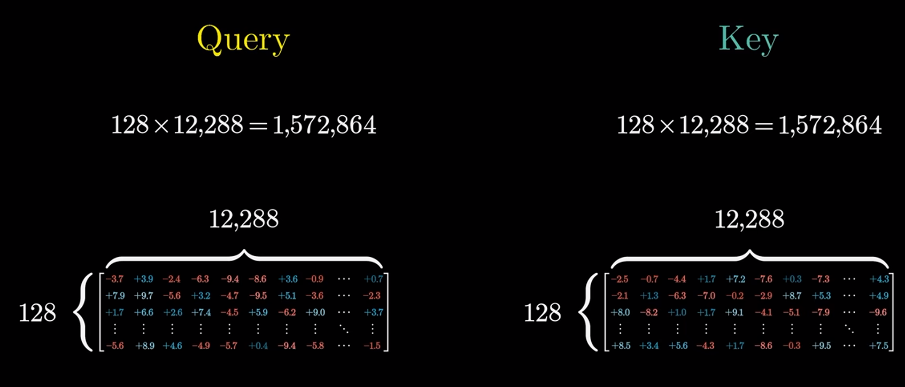
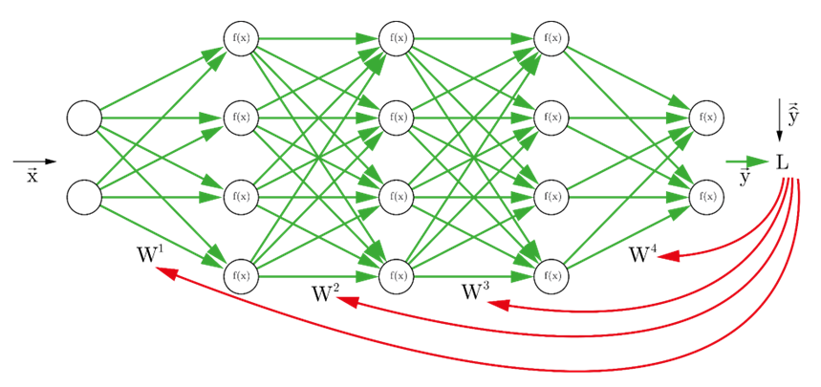
Adjusting Parameters
Many different Queries and Keyes can be used to extract different aspects of words’ meanings
Wq, Wk, Wv are weights (learnable parameters) which will be adjusted during training process using back-propagation
Despite our intuitive example, Queries, Keyes ,and Values are not interpretable easily and contain complex concepts and meanings
Neural networks are Blackbox models. We cannot easily interpret queries, keys and context inside self-attention layer

Slide 39
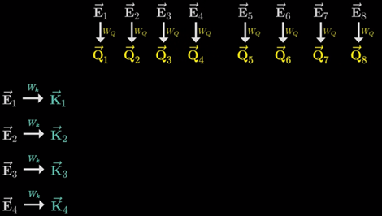
Self-Attention - Steps
The input is typically a sequence of initial word embeddings (or token embeddings), where each token in the sequence is represented as a vector.
For each input vector, three different vectors are extracted: Query (Q), Key (K), and Value (V). These vectors are computed by three learned weight matrices (Wq, Wk, Wv).
The alignment(relevance) between the Query vector of a token and the Key vectors of other tokens in the sequence is computed using a dot product for each pair.
The similarity scores are normalized, which converts them into a set of attention weights that sum to 1.
The output for each token is computed as a weighted sum of the Value vectors, where the weights are the attention weights obtained from the previous step.
The result is a new set of embeddings where each embeddings include a weighted combination of all the input embeddings to capture the context

Slide 40
Role of Self-Attention in NLP Phases
Many NLP phases including capturing syntactic dependencies and meaning of the words/tokens in different contexts besides discourse integration and some aspects of pragmatic analysis can be realized by self-attention mechanism.

Slide 41
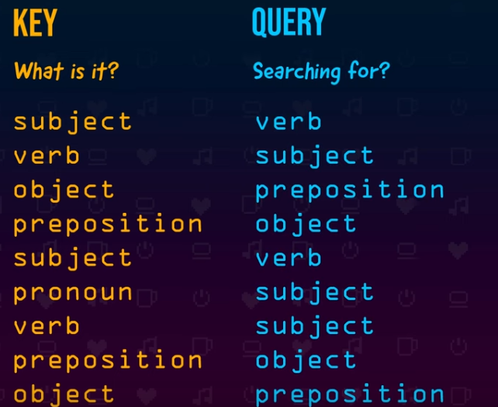
Syntactic Analysis
Some Queries and Keyes can be used to extract syntactic structure of the sentence:
Query1: Is there an adjective describes this noun?
Key1: This is an adjective which describes the noun
Query2: Is there a verb showing the act of this subject?
Key2: This is a verb showing the act of the subject

Slide 42
Semantic Analysis
Self-attention plays a crucial role in disambiguating word meanings in different contexts since it adds contextual embedding to general embeddings
Query, key vectors can reveal relevant words for contextual meaning of a word in a sentence and Value vectors can transform a general embedding to a contextual embedding
Self-attention also contributes to contextual understanding of a text which is essential for pragmatic analysis
bank
[0.3, 0.2, -0.8, …]
[0.9, -0.2, 1.6, …]
[-1.9, -0.4, 0.1, …]
open a bank account
on the river bank

Slide 43
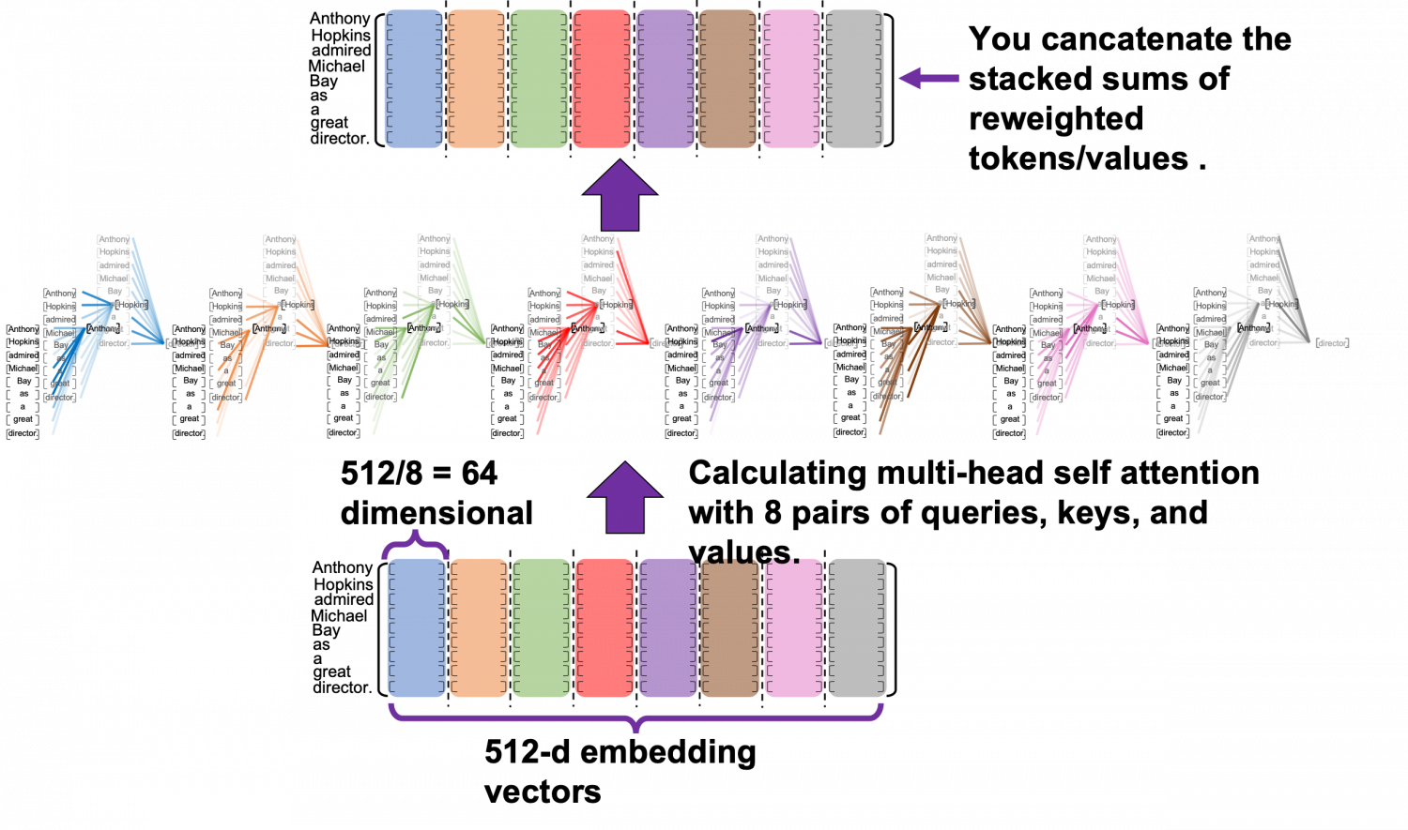
Pragmatic Analysis
For pragmatic analysis of a text, many other aspects of a text should be extracted:
Meaning of content regarding type of content (e.g. scientific, story , ..)
Meaning of content regarding topic of content
etc.
Example: Sentence 1 : Prince…UK…Harry → Type: News → News about prince Harry
Sentence 2 : Prince…Magic…Harry → Type: Story → Story about Harry Potter
Single-head attention focuses on one specific aspect
To extract information on several aspects of a text, we need several sets of Q,K,V
Understanding multiple contextual clues can facilitate pragmatic analysis

Slide 44
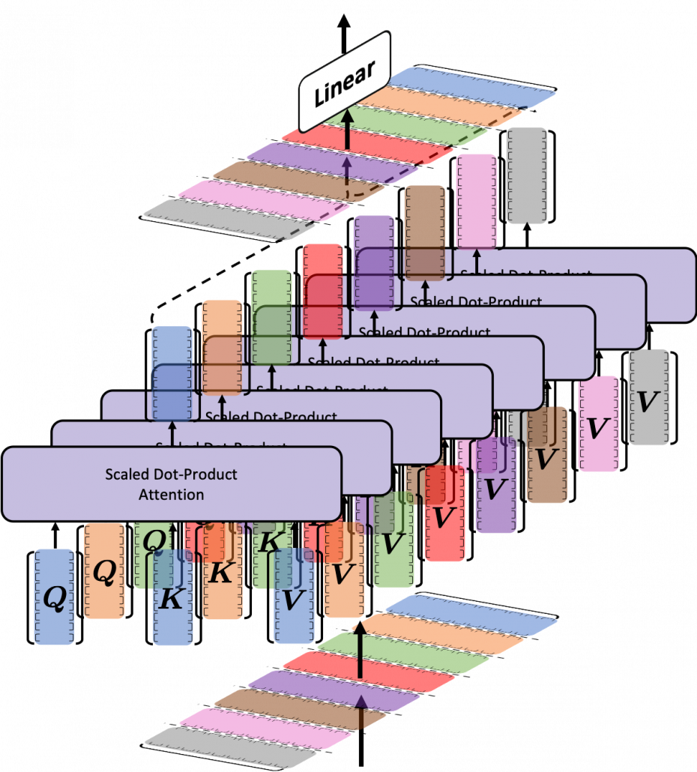
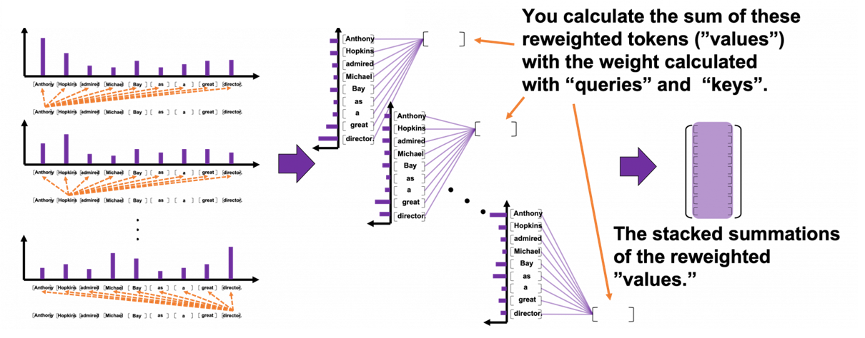
Multi-Headed Attention
Capturing different aspects of context can be done multiple times in parallel
Several attention block (Multi-head attention)
Each attention head is focused on one aspect
Need to combine the resulting output sums
GPT-3 has 96 attention heads
Multi- head Attention can be handled in parallel

Slide 45
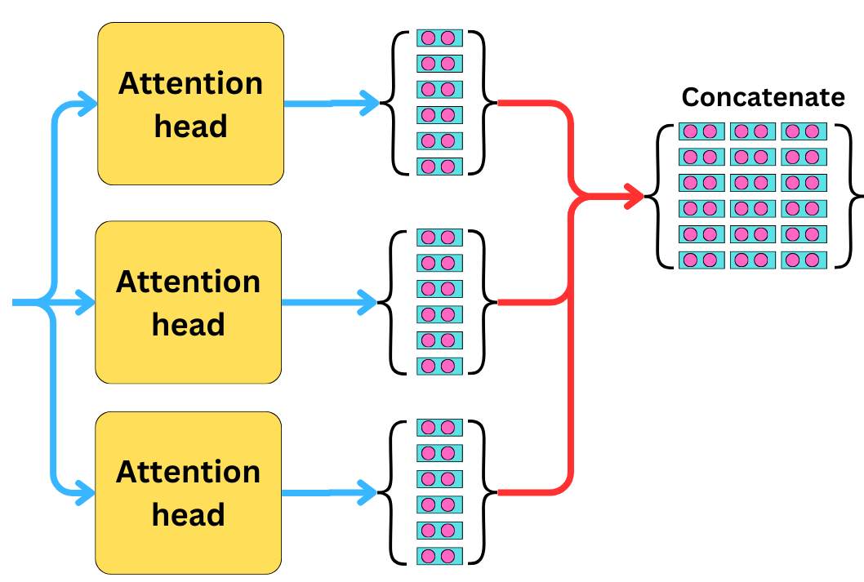
Dimension Reduction in Multi-head Attention
in multi-head attention, each head typically focuses on a subset of the dimensions of the embedding.
This allows the model to capture different types of relationships in the data while keeping the overall computational cost manageable.
Example:
d model​ = 12288 (input embedding size),
ℎ = 96 (number of heads),
𝑑𝑘=𝑑𝑚𝑜𝑑𝑒𝑙/ℎ = 128 (embedding size per head).
Embedding

Slide 46
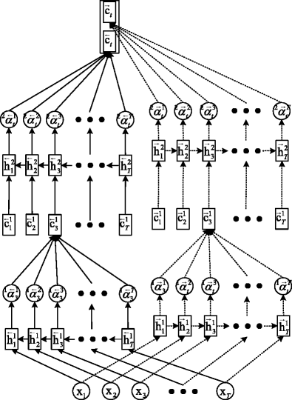
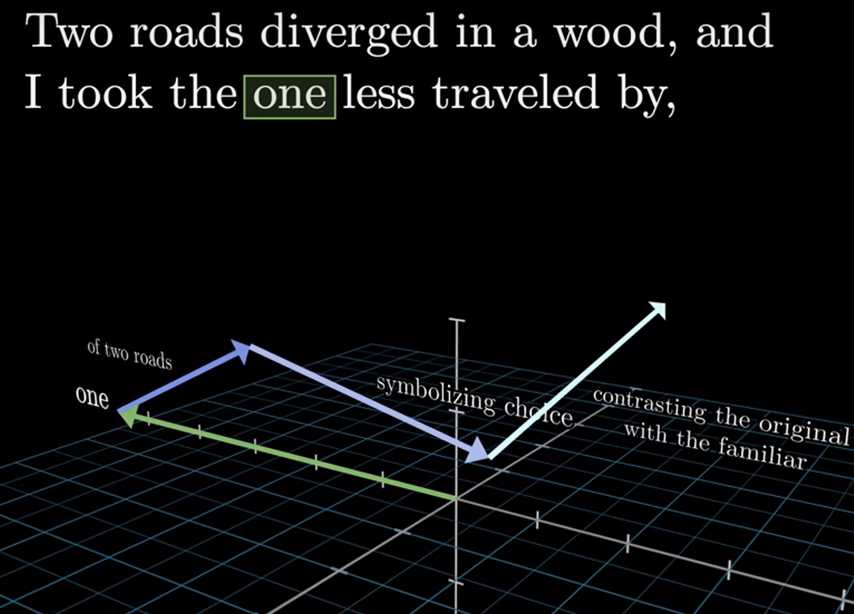
Discourse Integration
Stacking multiple layers (Multi-layer Attention) allows the model to build a hierarchical understanding of the text
Early layers focus on simple and syntactic relationships, while deeper layers capture higher-level semantics and more complex and abstract relations
Capturing long-range dependencies between words that might be far apart which is critical for discourse integration
GPT 3 has 96 attention layers
One refers to road

Slide 47

Self-Attention vs RNN
Despite the sequential processing in RNNs, self-attention is order agnostic
Self-attention captures long-range dependencies which cannot be captured by RNN attention

Slide 48
Order Agnostic vs Sequential - Example
In sequential approach previous words attend in the context of the next word
In an order agnostic approach every words attend the contextual meaning of every other words
Example: Meaning of “bank” in the following context:
“I got to the west bank. It is a region in the west side of a river.”
RNN : Sequential processing doesn't work well since there is no indication of the meaning of the bank in the first sentence
Self Attention: Transforms general embedding of “Bank” word regrading all other words in the context window

Slide 49

Context Window
The context window refers to the maximum number of tokens that the model can consider simultaneously when processing or generating text.
It defines the scope within which the self-attention mechanism can operate.
BERT: Typically uses a fixed context window size of 512 tokens.
GPT-2 and GPT-3: The context window sizes are 1024 and 2048 tokens.
Standard GPT-4 : Uses a fixed context window size of 8192 tokens
GPT-4 with Extended Context Version: Up to 32,768 tokens
Gemini 1.5 Pro: Up to 2M context window

Slide 50

Word Embeddings using BERT
BERT (Bidirectional Encoder Representations from Transformers) is an LLM contains self-attention mechanism.
In BERT, the initial values of word embeddings are typically randomly initialized.
Input sequence of tokens are embedded and then processed using self attention mechanism.
The output is a sequence of embeddings, each corresponding to an input token, presenting contextual meaning of tokens.

Slide 51

Embeddings - BERT
Use word pieces tokenization (30K token vocabulary)
Embedding size: 768 dimensions / 1024 dimensions (BERT-large)
Each token is sum of three embeddings
Sum of embeddings

Slide 52
Different Types of Embeddings
Token Embeddings: These are the embeddings corresponding to each word (or subword token) in the input sequence.
Position Embeddings: These embeddings indicate the position of each token within the sequence, allowing BERT to understand the order of the tokens.
Segment Embeddings: These embeddings indicate which sentence (or segment) each token belongs to.
Example:
For a pair of sentences like "I went to the store." and "I bought some milk.", the input to BERT would include:
Token Embeddings: Representations of each token like "I", "went", "to", etc.
Position Embeddings: Indicating the position of each token in the sequence.
Segment Embeddings:
All tokens from "I went to the store." would get a Segment A embedding.
All tokens from "I bought some milk." would get a Segment B embedding.

Slide 53

Order of Words in NLP Tasks
Without position of words, language models would lose the ability to distinguish the arrangement of tokens, leading to incorrect or poor predictions or text generation.
Relative and absolute positions of tokens in a sequence, allowing the model to understand their order.
Self-attention is order agnostic
It needs a mechanism to add positions

Slide 54


Positional Encoding
Positional embedding is a vector that represents position of each token
Need for information about the position and order of tokens in a sequence
Adding position to self-attention mechanism
Addition the position embedding to the word embedding vector
Sinusoidal position representation

Slide 55


Sinusoidal Positional Encoding
Sine and cosine functions of different frequencies can be used for providing unique values for positional encoding
These functions are limited (the effect of position in total embedding will be limited)
Despite the limited range, it can be used with long sequence due periodic nature of the function.
The function addresses relative positions efficiently

Slide 56

BERT vs Word2vec
Contextual Understanding:
BERT model can capture the meaning of each word in different contexts.
Word2vec is not capable to capture contextual meaning of the words so that it generates static embeddings only.
Out-of-Vocabulary Handling:
BERT can use sub-word tokens which effectively handle out-of-vocabulary (OOV) words
Word2vec doesn’t has any sub-word tokenization feature so, it can’t handle OOV effectively.

Slide 57

General Embedding using BERT
BERT provides different embeddings for the same word depending on the context using attention mechanism. This is different from traditional word embeddings that give a single vector for a word.
To get a general embedding for a word across multiple contexts, you could average the embeddings of the word across different sentences or contexts.

Slide 58

Performance of Embedding Model
By decoding vector embeddings, it is possible to check performance of the embedding model (E.g., if words like "king" and "queen" are close together in the vector space, it suggests that the model understands their semantic relationship)
Visualizing:
When visualized, embeddings where semantically similar is near together:
t-distributed Stochastic Neighbor Embedding (t-SNE)
Principal Component Analysis (PCA)
Linear Discriminant Analysis (LDA)
Detecting Near Embeddings:
To detect near embeddings, a similarity measure is typically used to compare the similarity between vectors.

Slide 59


Detecting Near Embeddings
Cosine Similarity: Measures the cosine of the angle between two vectors. It's widely used in NLP since it emphasizes the direction of the vectors.
Embedding Clustering
Another approach for detecting near embeddings involves clustering algorithms like K-means ​.
Embeddings where semantically similar form a cluster

Slide 60

Debiasing Embeddings
Debiasing embeddings refers to techniques used to reduce or eliminate bias in word embeddings or contextualized embeddings produced by large language models (LLMs).
Word embeddings often capture societal biases, such as gender, racial, and cultural stereotypes
Common Debiasing Techniques:
Hard Debiasing
Soft Debiasing

Slide 61

Hard Debiasing
Goal: Remove bias by projecting the embeddings to a subspace where the biased information (e.g., gender bias) is removed.
Method: First, identify a "bias subspace" (e.g., the direction corresponding to gender in the embedding space). Then, neutral words (e.g., "doctor," "nurse") are projected onto a plane orthogonal to this bias subspace, effectively eliminating the bias.
Removing bias entirely can sometimes result in a loss of important semantic information

Slide 62

Soft Debiasing
Rather than completely eliminating bias, soft debiasing aims to reduce bias while preserving as much information as possible.
Similar to hard debiasing but instead of entirely removing the bias component, soft debiasing involves partially reducing its impact to maintain semantic richness while still reducing bias.
During training, sentences or phrases that reflect biased assumptions are rephrased to counter the bias. For example, for "he is a doctor" from the training data, it would provide an augmented example like "she is a doctor" to balance the gender association.

Slide 63
Future Directions in LLM Embeddings
Efficient Embedding Techniques: Developing techniques that balance precision with computational efficiency. This includes exploring methods to reduce the size of embeddings without compromising their quality.
Domain-Specific Embeddings: Developing embeddings tailored to specific industries or applications. For example, embeddings designed for medical data can capture the unique characteristics and relationships of medical terminology, improving the performance of models in healthcare applications.
Multi-Modal Embeddings: Vector representations that integrate information from multiple modalities, such as text, images, audio, and video. These embeddings aim to create a unified representation that captures semantic relationships across different types of data.

Slide 64

Multi-Modal Embedding
Uni-modal Embeddings:
Generated from a single type of input data (e.g., text), capturing the semantic context within that modality.
Uni-modal embeddings are used in tasks specific to one type of data.
Multi-modal Embeddings:
Generated same vector space from multiple types of input data (e.g., text and images), capturing the relationships and interactions across different modalities.
Multi-modal embeddings are crucial for tasks that require understanding the interplay between different types of data. For instance, in a video with subtitles, multi-modal embeddings can help the model understand the relationship between the visual content and the accompanying text.

Slide 65
Assignment 5
Train Word2Vec model on text8 data using all combinations of the following hyper-parameters:
win_size = [3,7,13,25]
vector_size = [20,70,100,300]
After each training using a set of parameters, perform the following tasks:
Define Transform as Embedding('man') - Embedding( 'woman')
Find an embedding most similar to (Transform + Embedding('daughter’))
Cluster the following embeddings using K-means:
'yen', 'yuan', 'france', 'brazil', 'africa', 'asia’
By assessment of the results of transformation and clustering, choose the best hyper-parameters for this training data

